Slide 1
Node JS – Part 2 promises & async flow
Amir Yahalom, SAP.

Slide 2
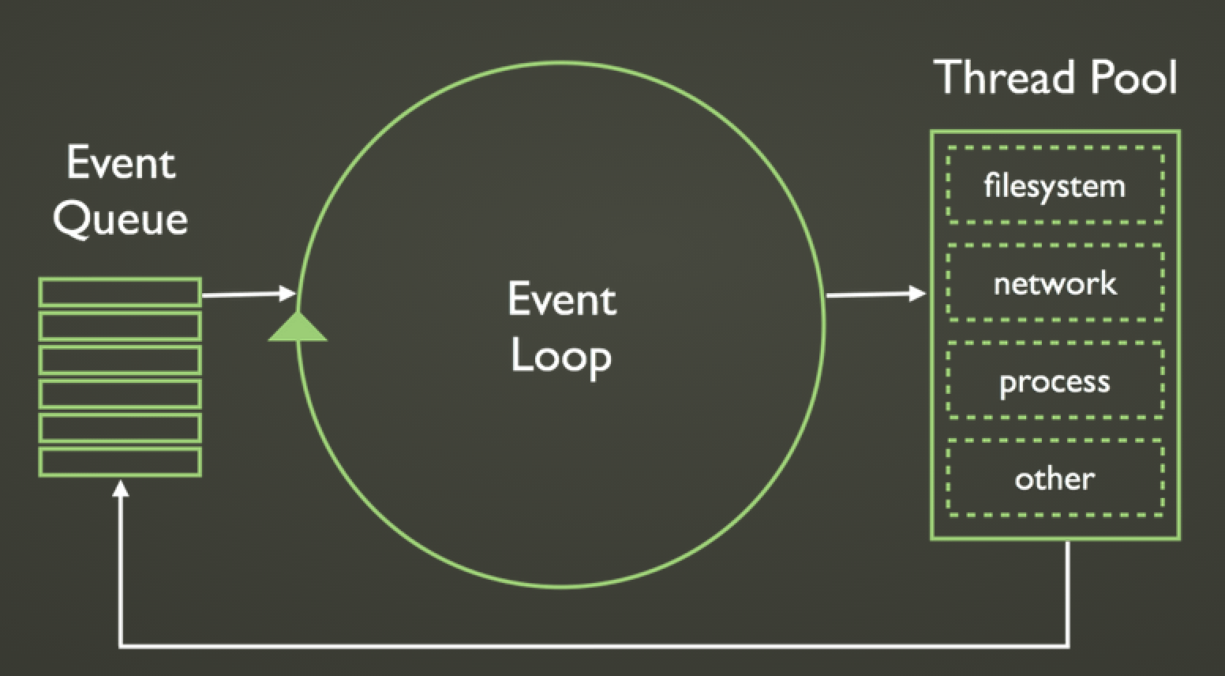
Async code
callback

Slide 3
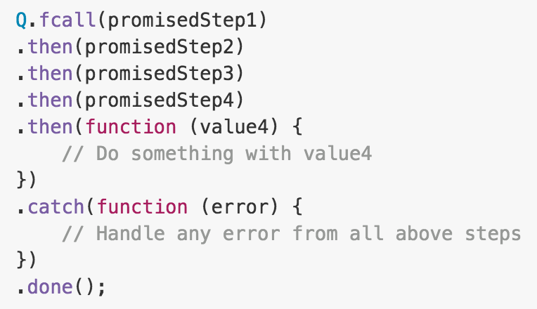
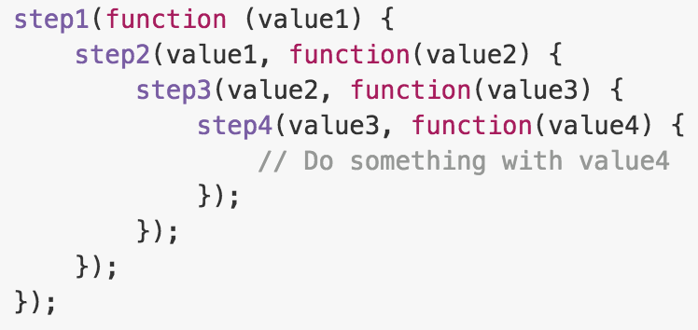
“Callback hell” vs. Promise chain

Slide 4
“Callback hell” vs. Promise chain
Promise 1
Callback 1
Error
Callback 2
Promise 2
Callback 3
.
.
.
Promise 3
.
.
.
Catch
Finally

Slide 5
Promise chain visualization

Slide 6
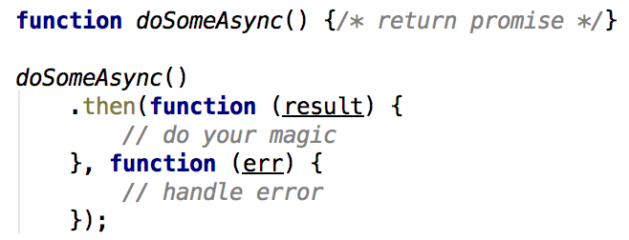
Q – promises
Promises have a then method, which you can use to get the eventual return value (fulfillment) or thrown exception (rejection): Promise.prototype.then(fnOnResolve[, fnOnReject][, fnOnProgress])
Other methods for the Promise.prototype of Q:
fail(fn) – shorthand for reject callback
catch(fn) - handling errors in a promise chain
finally(fn) – acts like a finally clause on a promise chain
progress(fn) – shorthand for progress callback

Slide 7
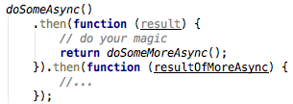
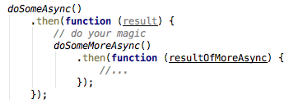
Q – promise flow
then() returns a promise so you can do chaining:
Or nesting if you want to use variables in closure:

Slide 8
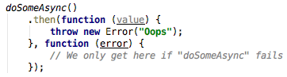
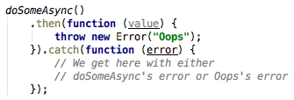
Q – handling errors
If an error is thrown within a resolve handler, it won’t be caught by the reject handler of the same “then”:
You can use catch in order to wrap the entire chain:

Slide 9
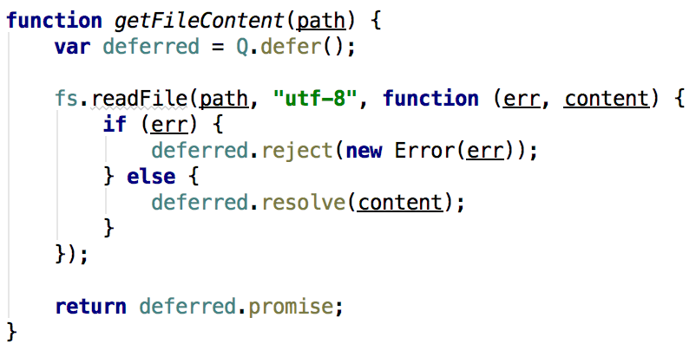
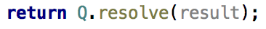
Q – creating promises
Deferred object
Q.resolve() / Q.reject() – create resolved/rejected promise

Slide 10
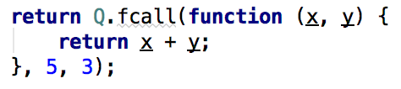
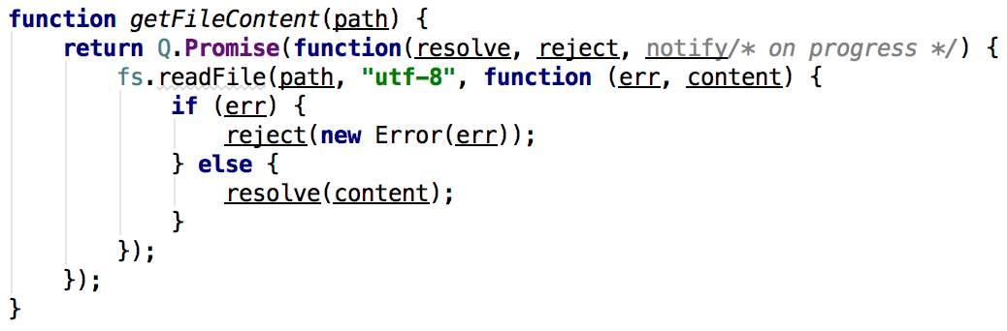
Q – creating promises
Q.fcall – wraps the given function into a promise:
Q.Promise – similar to deferred:

Slide 11
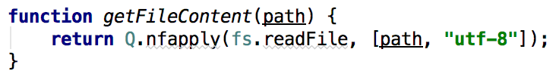
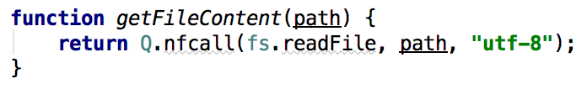
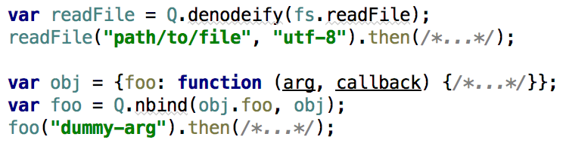
Q – adapting Node style functions
Q can wrap Node-async-style functions - callback(err, results) as last param
Q.nfcall / Q.nfapply –wrap and call function
Q.denodeify / Q.nbind for reusable wrappers

Slide 12
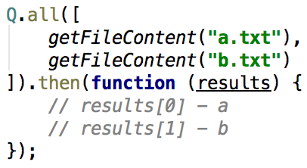
Q – promises combination
Q.all if you want to run multiple functions

Slide 13
Exercise/promise
Complete TODOs in test/promise.spec.js (not related to the second task)
Complete the TODOs in utils.js
Use lstat to get file stats so you could know whether it is a directory
Make fs functions promised
main.js need to include the following logic:
Read the desired directory (absolute path) and file pattern from program parameters
Search for files in the given directory recursively
loop on each file in the given directory
If it is a directory → search recursively
If a file match the pattern → print it’s path to the console
Run cmd: node main.js ”/Users/…/repos/cpv2/” “*.xml”
→ Print path of all the .xml files located in cpv2 directory

Slide 14
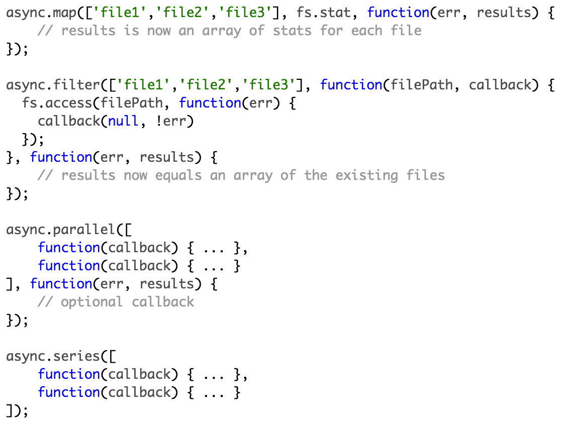
Async - asynchronous control flow
Provides functions for working with asynchronous code
Common pitfalls

Slide 15
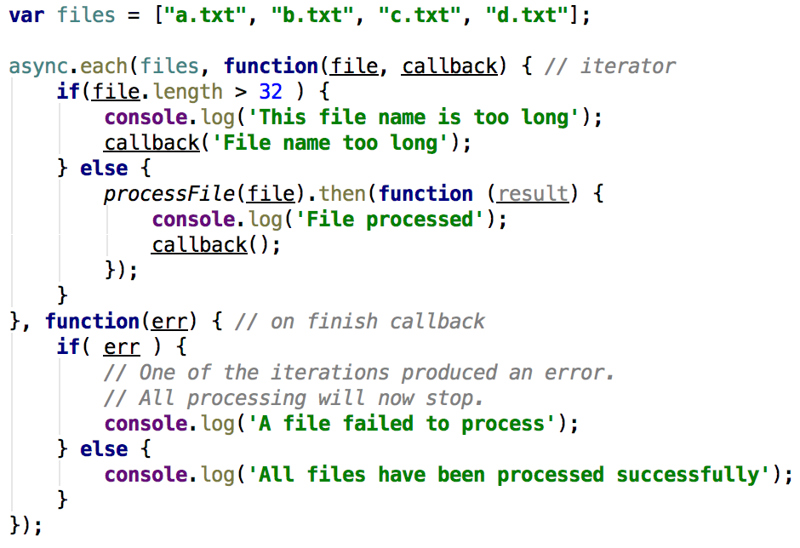
Async
Async.each() – executing async operation on each element in array

Slide 16
Exercise/async
Write the promise exercise (files) with one of async methods

Slide 17
Links
Promises in Node.js with Q – An Alternative to Callbacks
JS Promises for Dummies

Slide 18
Thank You

